Slide 1

Getting started…
Please sit in rows A through J only
Form groups of 3-5 students
Discuss: what are you most confused about?
Post questions on Ask For Me!

Slide 2
Sampling Distributions to Confidence Intervals (continued)
Psych 100A Spring 2019
Prof. Jim Stigler

Slide 3
Which distribution?

Slide 4
Which distribution should I use?
I’m making a new ride for a theme park. It’s not safe for anyone less then 60 inches tall to ride on it. What percentage of park attendees will be ineligible to ride?
DGP? Or sampling distribution?

Slide 5
Which distribution should I use?
In order to get state approval for my ride, I need to show that the average weight of the 10 people that fit into each car will be less than 150 pounds 99.9% of the time.
DGP? Or sampling distribution?

Slide 6
Analyzing ScienceData
A practical application of sampling distributions

Slide 7
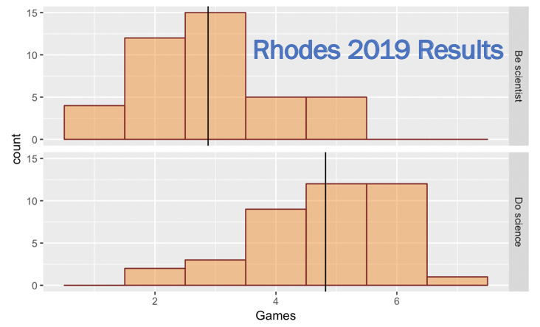
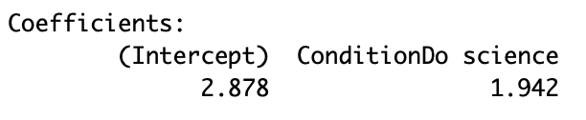
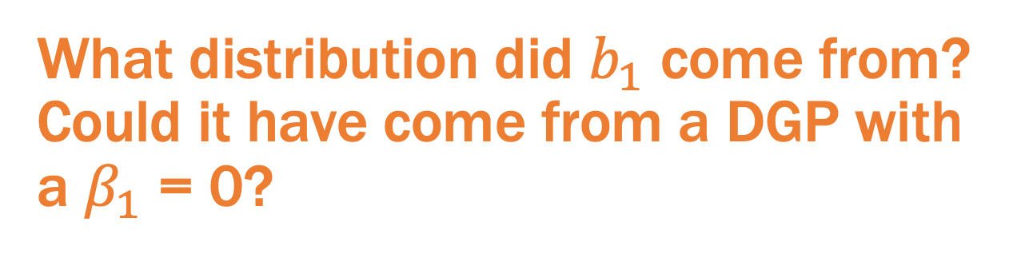
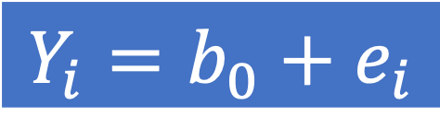

$$Y_{i}=b_{0}+b_{1}X_{i}+e_{i}$$
$$Y_{i}=b_{0}+e_{i}$$
What distribution did $b_{1}$ come from? Could it have come from a DGP with a $β_{1}$ = 0?

Slide 8
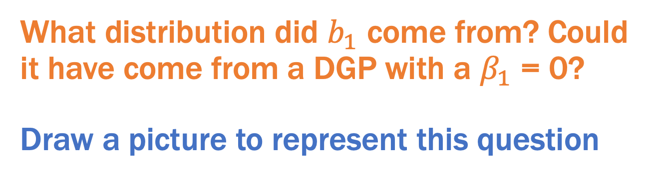
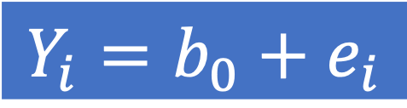
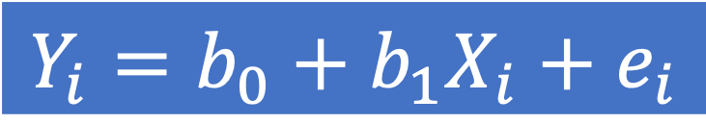
$$Y_{i}=b_{0}+b_{1}X_{i}+e_{i}$$
$$Y_{i}=b_{0}+e_{i}$$
What distribution did $b_{1}$ come from? Could it have come from a DGP with a $β_{1}$ = 0?
Draw a picture to represent this question

Slide 9
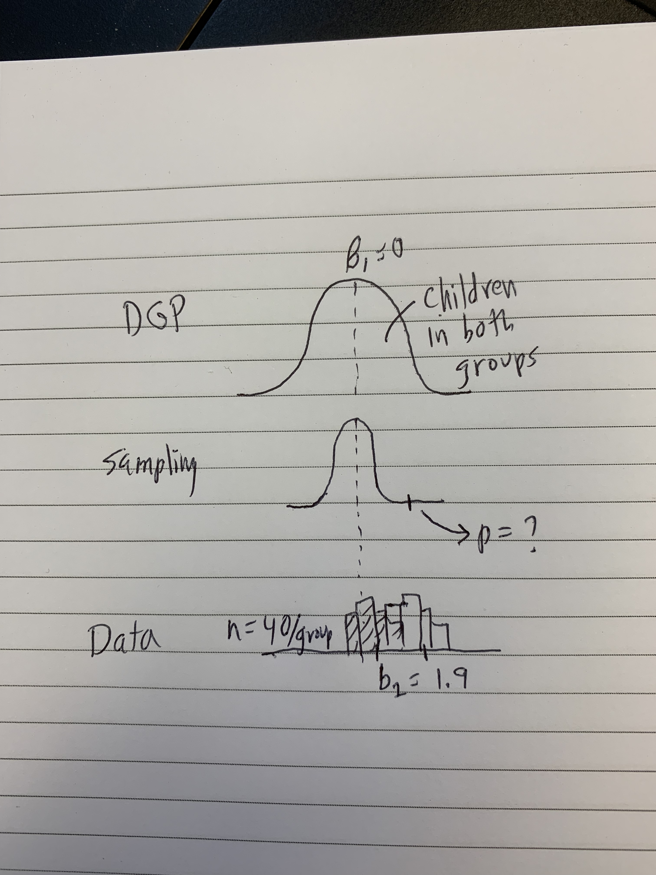
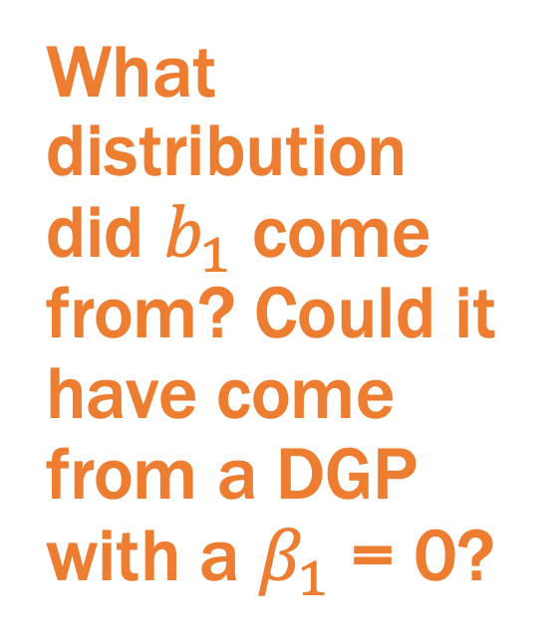
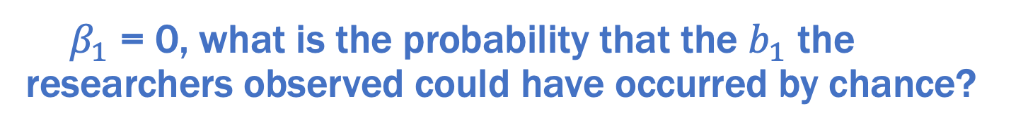
My Picture with Sampling Distribution
What distribution did $b_{1}$ come from? Could it have come from a DGP with a $β_{1}$ = 0?
If ${ β}_{1}$ = 0, what is the probability that the $b_{1}$ the researchers observed could have occurred by chance?

Slide 10
Four ways of creating sampling distributions
Simulation
Randomization
Bootstrapping
Mathematical models
Let’s use simulation to answer this question.

Slide 11
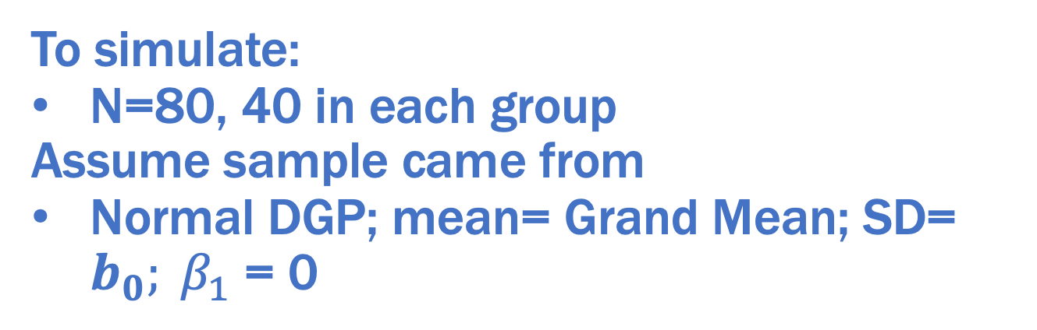
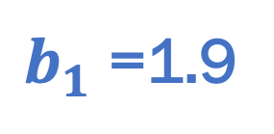
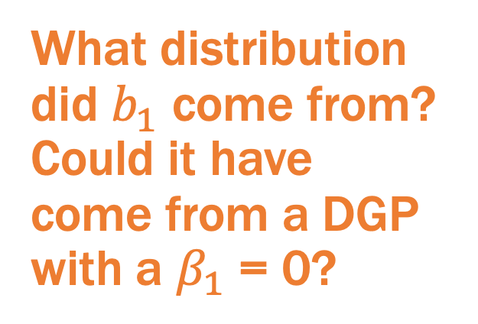
What distribution did $b_{1}$ come from? Could it have come from a DGP with a $β_{1}$ = 0?
$b_{1}$ =1.9
To simulate:
N=80, 40 in each group
Assume sample came from
Normal DGP; mean= Grand Mean; SD= $b_{0}; β_{1}$ = 0

Slide 12
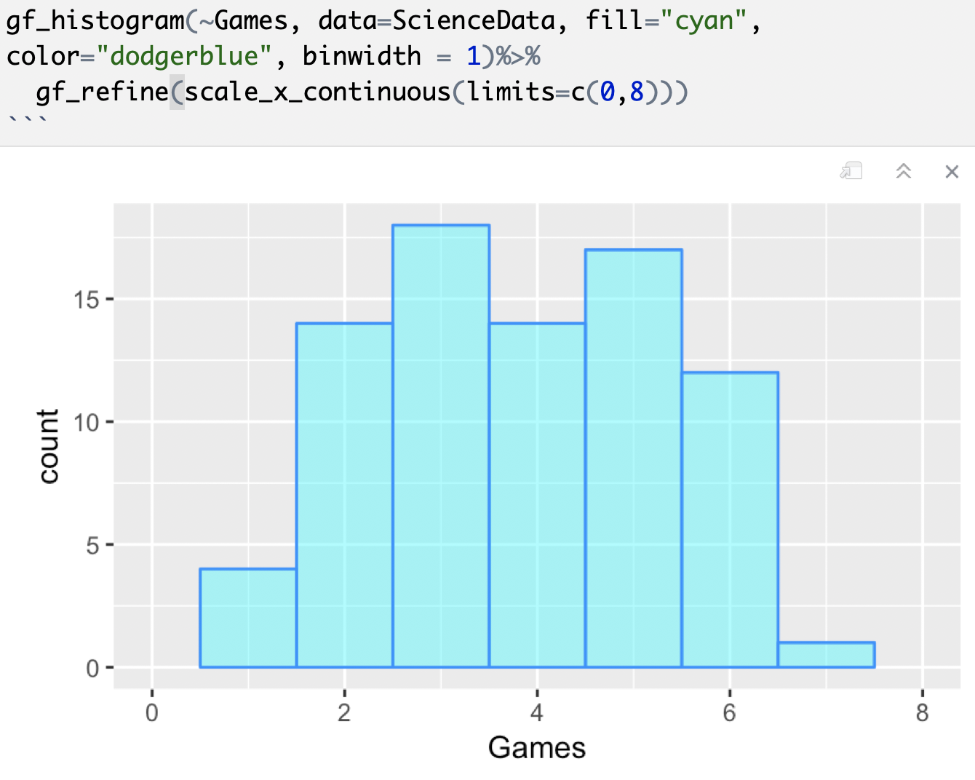
Distribution of Games: Assume Normal?

Slide 13
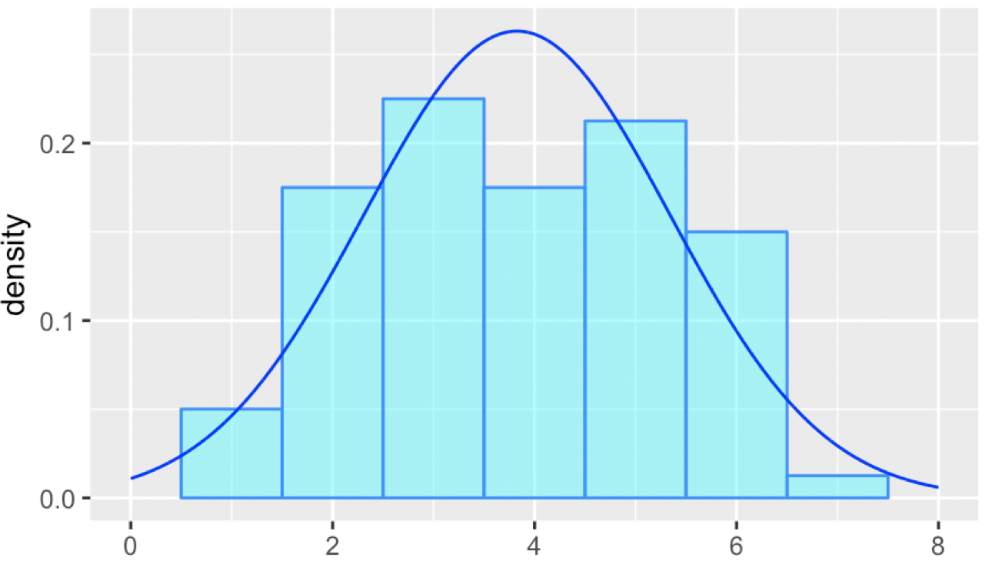
Distribution of Games: Assume Normal?
M=3.83; SD=1.52

Slide 14
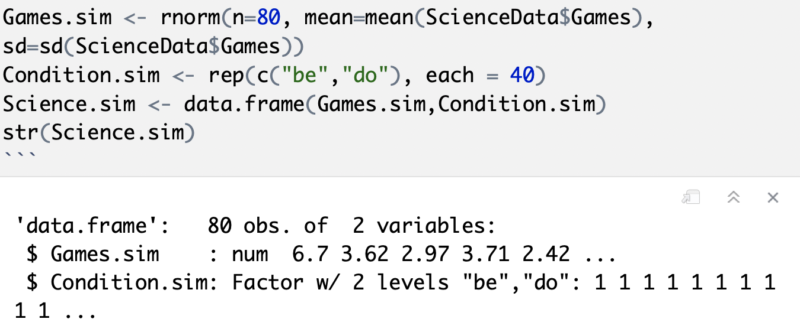

Simulate a single random sample
If I make a histogram of Games.sim, will it be a sampling distribution?

Slide 15
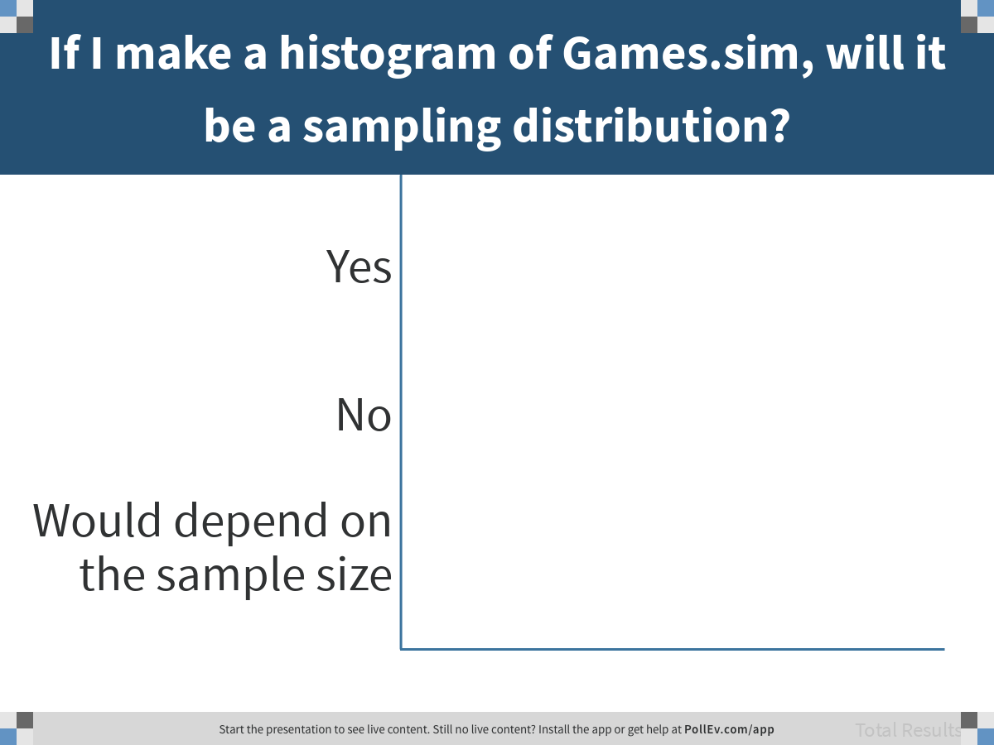
Notes:
If I make a histogram of Games.sim, will it be a sampling distribution?
https://www.polleverywhere.com/multiple_choice_polls/StqhrYPtAsjSMUf3zVff1

Slide 16
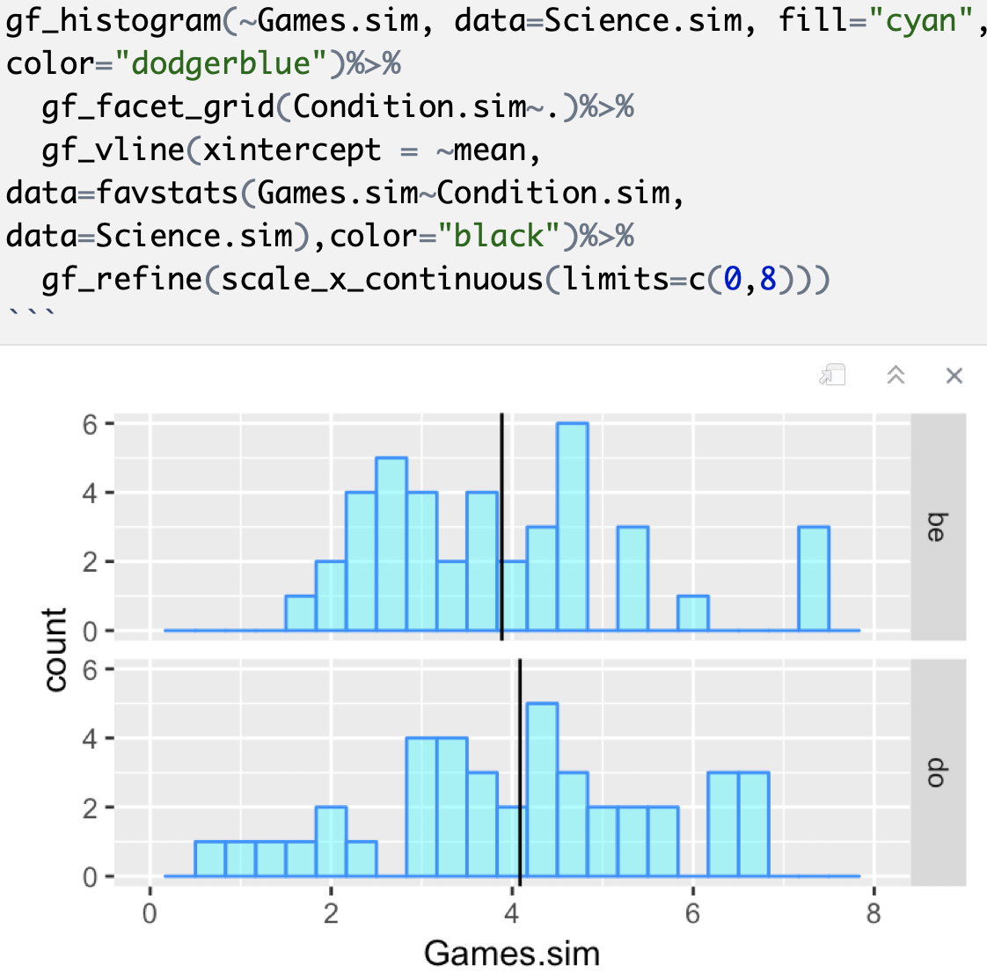
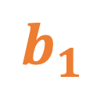
$$b_{1}$$

Slide 17
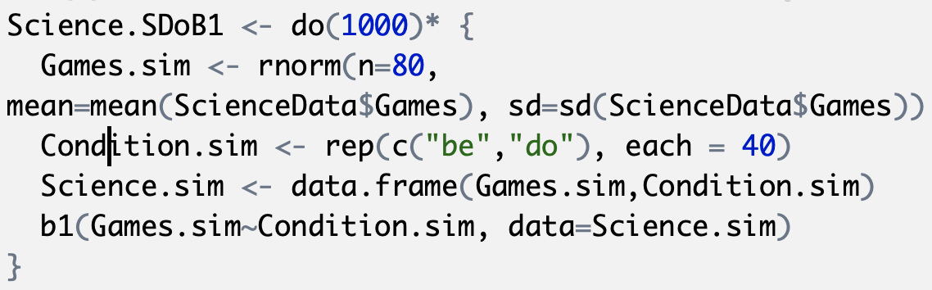
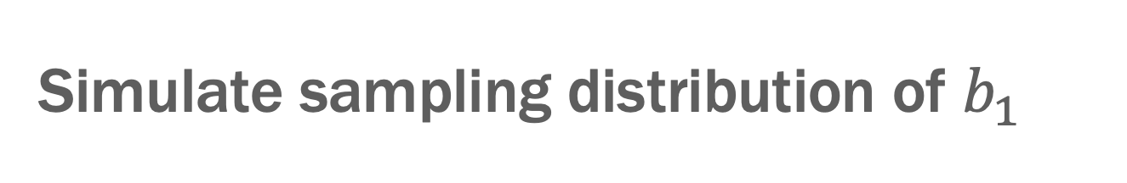
Simulate sampling distribution of $b_{1}$
Discuss: What will be the shape of this sampling distribution? What will be center? What will be the spread?
Will the mean of this sampling distribution tell us the mean of the DGP?

Slide 18
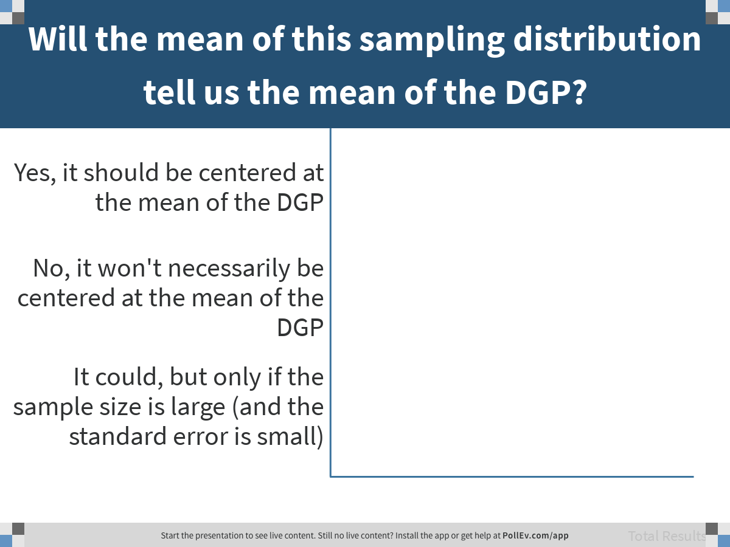
Notes:
Will the mean of this sampling distribution tell us the mean of the DGP?
https://www.polleverywhere.com/multiple_choice_polls/efdSSThb9mouQsXf0KZUr

Slide 19
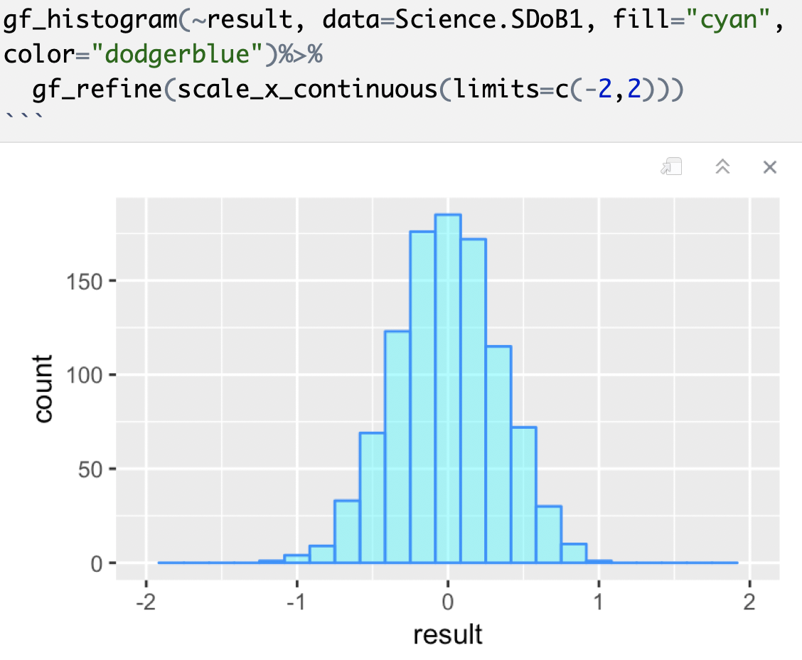
Simulate sampling distribution of $b_{1}$

Slide 20
Why did we make this sampling distribution? What question were we trying to answer?

Slide 21
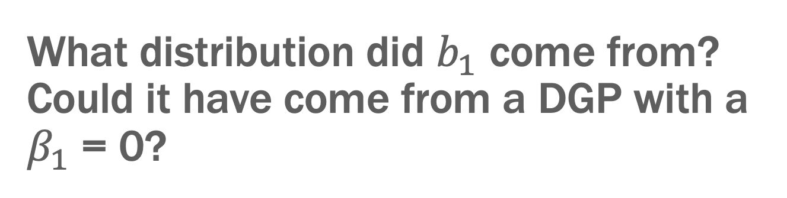


What distribution did $b_{1}$ come from? Could it have come from a DGP with a $β_{1}$ = 0?
$$Y_{i}=b_{0}+b_{1}X_{i}+e_{i}$$
$$Y_{i}=b_{0}+e_{i}$$
p=?

Slide 22
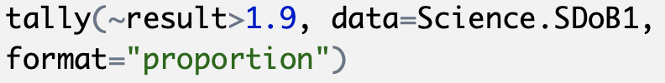
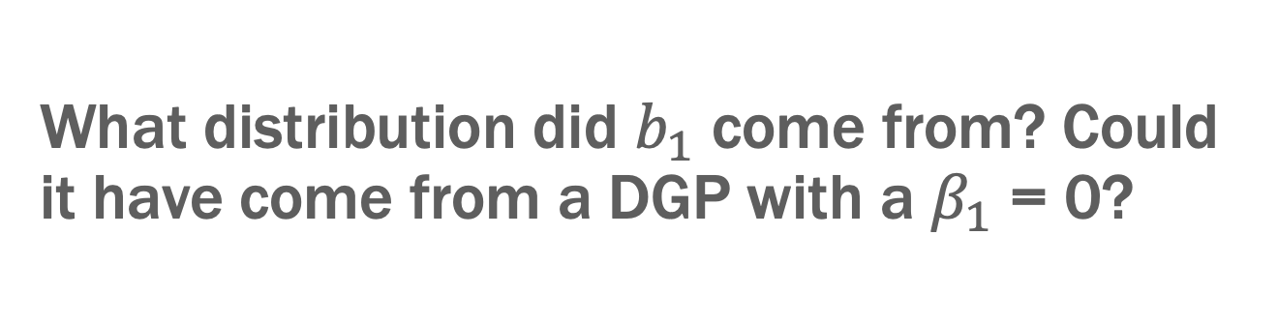

What distribution did $b_{1}$ come from? Could it have come from a DGP with a $β_{1}$ = 0?
$$Y_{i}=b_{0}+b_{1}X_{i}+e_{i}$$
$$Y_{i}=b_{0}+e_{i}$$
p=.000
Discuss: What does this result mean? (Use your picture)

Slide 23
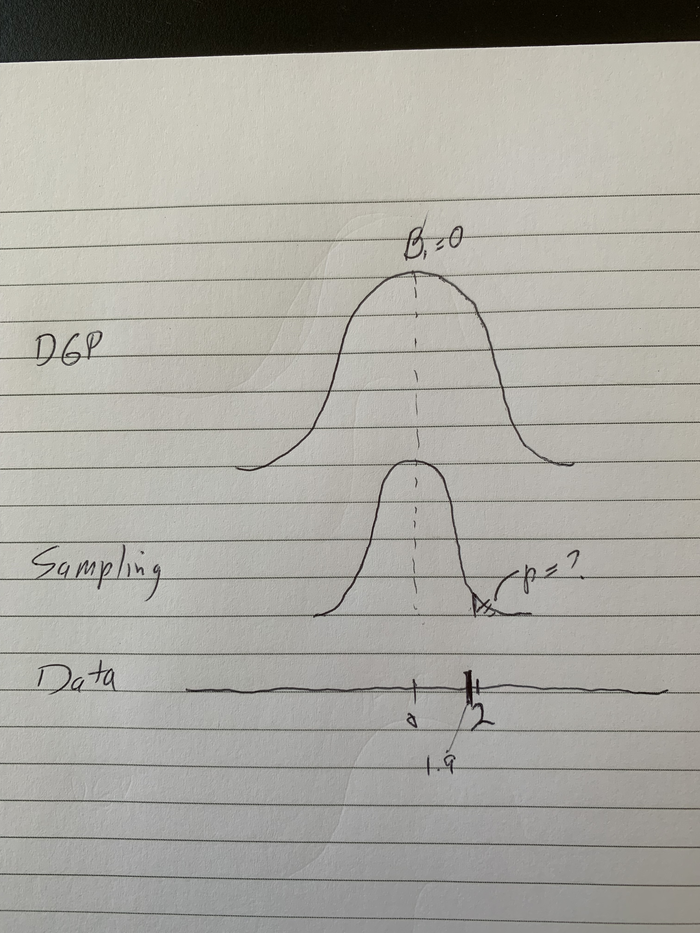
My drawing

Slide 24
Cut and move: the basis for confidence intervals

